Slide 1
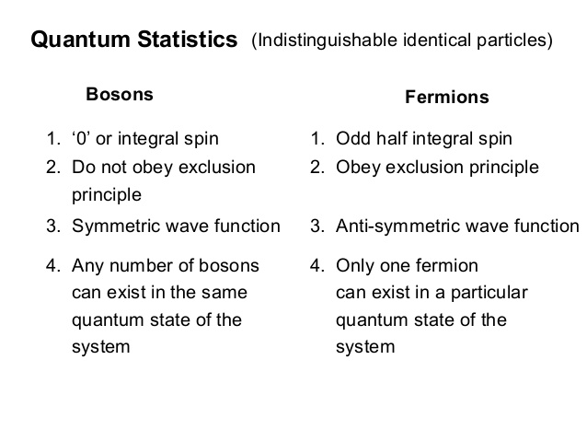
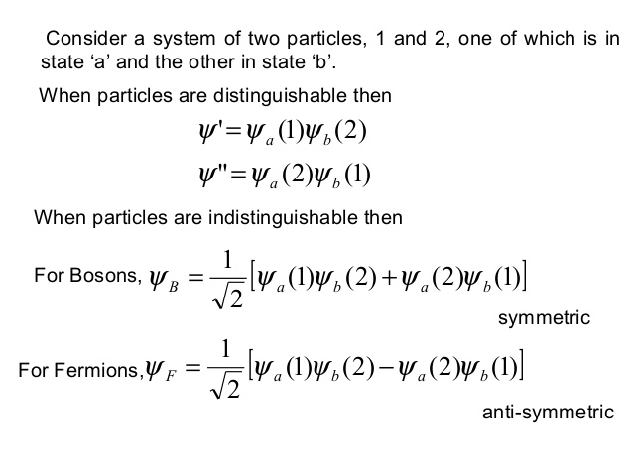
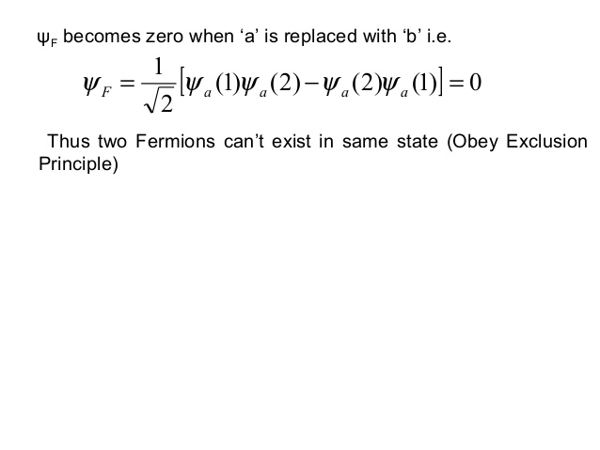
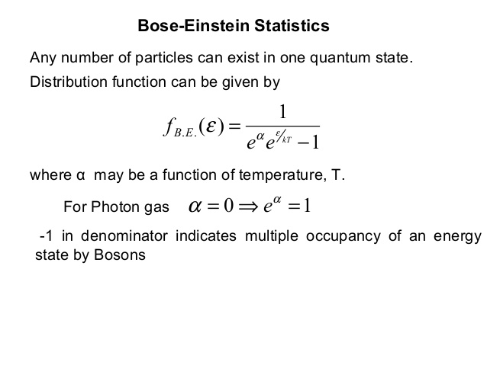
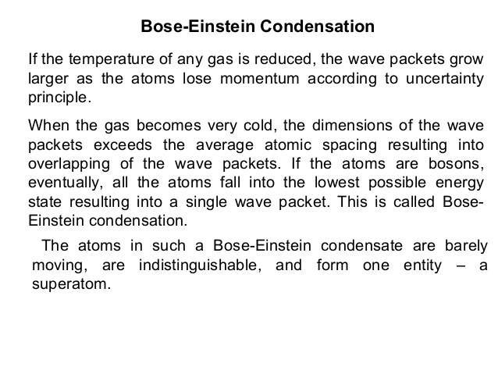
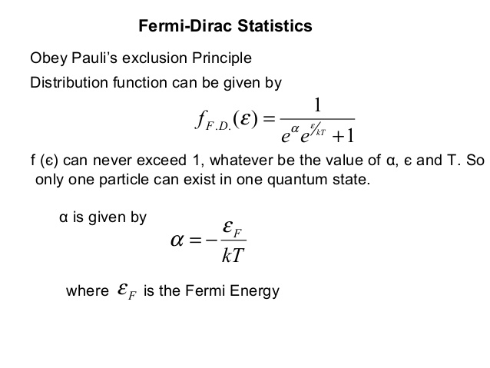

Slide 3
Bosons and Bose –Einstein Distribution
In systems consisting of collections of identical fermions or identical bosons, the wave function of the system has to be either antisymmetric (for fermions) or symmetric (for bosons) under interchange of any two particles, respectively.
With the allowed wave functions, it is no longer possible to identify a particular particle with a particular energy state. Instead, all the particles are “shared” between the occupied states. The particles are said to be indistinguishable.
The wave function for a system of identical bosons must be symmetric with respect to the interchange of any two of the bosons. For example, with two bosons, a possible wave function might be:

Slide 4
Here, x1 and x2 are the coordinates of the two particles, and A and B are the two occupied states.
If we put two particles into the same state, the wave function does not vanish: there is no limit on the number of particles we can put into any given state.
The Pauli exclusion principle does not apply to bosons: and this implies that the Fermi-Dirac distribution does not apply either, since the Pauli exclusion principle follows from the Fermi-Dirac distribution.
To find a distribution function to describe systems of bosons, we write down the number of microstates for the possible distributions, subject to constraints determined by the macrostate specifications.
Then we look for the distribution with the largest number of microstates: applying the principle of equal a priori probabilities, this distribution is more likely to occur than any other.

Slide 5
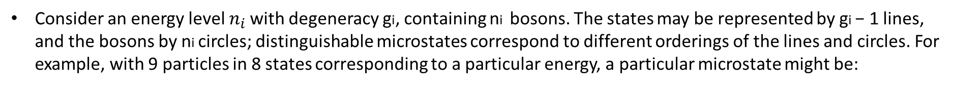
Consider an energy level $n_{i}$ with degeneracy gi, containing ni bosons. The states may be represented by gi − 1 lines, and the bosons by ni circles; distinguishable microstates correspond to different orderings of the lines and circles. For example, with 9 particles in 8 states corresponding to a particular energy, a particular microstate might be:
The number of distinct orderings of lines and circles is:

Slide 6
A particular distribution has a specified number of particles ni within each of the possible energy levels ni. The total number of microstates for a given distribution is therefore:
Let us assume that each state has a high degeneracy, i.e.gi >> 1. Then we can make the approximation:
To find the most probable distribution, maximize the above equation,

Slide 7
subject to the constraint on the total number of particles:
and the constraint on the total energy:
Rather than maximise t directly, we maximise ln t. If we assume that both gi and ni are large enough for Stirling’s approximation to hold for ln gi! and ln ni!, we find that ln t is given by:
The change in ln t resulting from changes dni in each of the populations ni is then:
Eqa ( 1)

Slide 8
From the constraint equations shown in the blue colour, we will get
Eqa (2)
Combining (1) and (2) with Lagrange multipliers α and β , we have:
Eqa (3)
For appropriate values of α and β , equation (3) is true for all dni, hence:

Slide 9
We then find that the most probable distribution can be written
Above equation is known as Bose-Einstein distribution. It gives the population of an energy level that has energy εi and degeneracy gi.
The constants α and β are determined from the constraints on the total number of particles and the total
energy. can, as usual, be related to the thermodynamic temperature, so that the Bose-Einstein distribution takes the form:

Slide 12
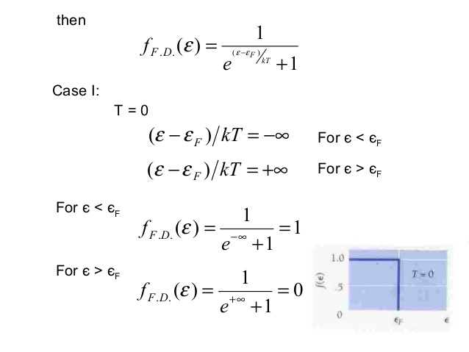

Slide 13
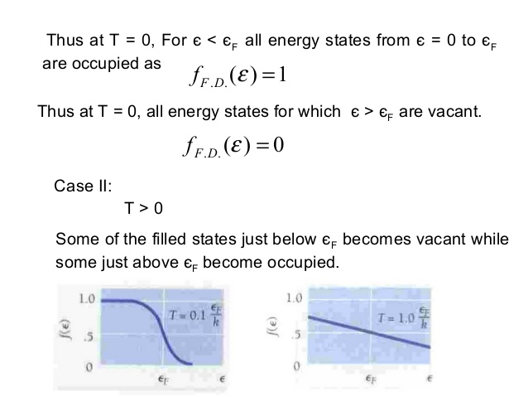

Slide 14
